Slide 1
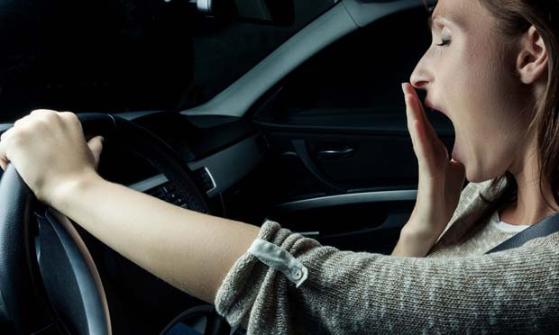
MIT-5432 Machine Learning A Deep-Learning Approach to Driver Drowsiness Detection
Junaidov Shohruz Srija Jasthi Vishal Reddy Musku

Slide 2

Agenda
Domain Introduction
Task Introduction
Dataset Introduction
Problem Formulation
Model Architecture
Implementation code snippets
Testing results from the code
Comparison
Discussion
Conclusion

Slide 3

Domain Introduction
Computer vision is a subset of computer science and focuses on enabling computers to identify and understand visual content.
Purpose:
Seeks to replicate human visual and cognitive abilities.
Automates tasks that mimic human capabilities.
Applications:
Extensive practical applications across various industries.
Essential for modern technological innovations and solutions.
Project Applications:
Used in our project to detect driver drowsiness.
Analyzes facial features, particularly the eyes, to assess alertness.
Relevance:
Enhances safety by identifying potentially sleepy drivers.
Prevents accidents caused by drowsiness.

Slide 4
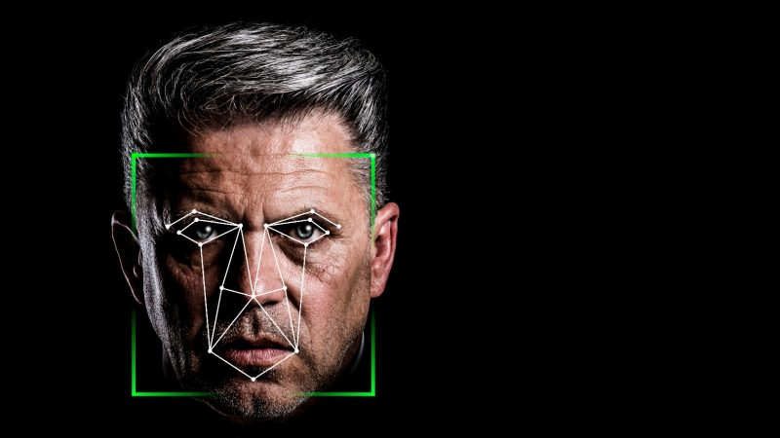
Task Introduction
Image Classification:
Classify the main subject of an image
Outputs a label for the image, e.g., "Human" for an image of a human.
Object Detection:
Recognizes multiple objects within an image.
Not only labels but also locates objects by drawing boundaries
Project Tasks:
First Task: Identifying the location of eyes on a human face in an image.
Second Task: Classifying the state of the eyes as 'open' or 'closed'.
Focus on analyzing eye states to detect drowsiness.

Slide 5
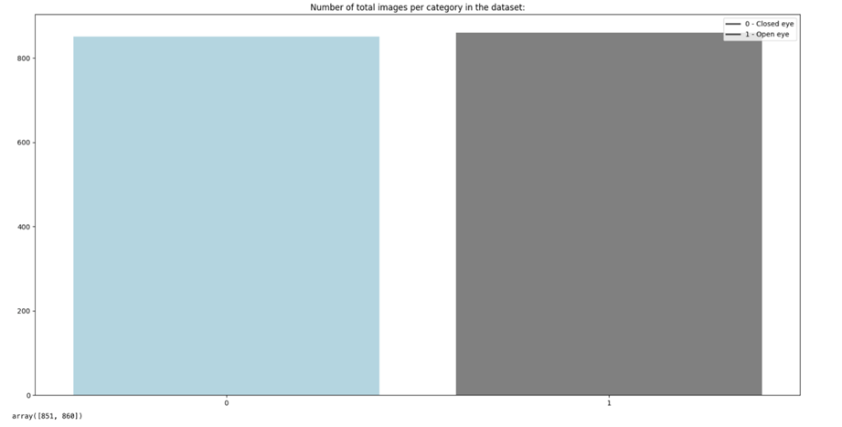
Dataset Introduction
Sourced from an AWS S3 bucket and Kaggle.
Total of 2852 images, divided equally between open (1) and closed (0) eye categories
Dataset Distribution:
Training: 60% (1711 images)
Testing: 40% (1141 images), with 30% of these used for validation.
Size: 128x128 pixels, grayscale.
Even distribution between categories across all dataset splits.
Number of images per category training dataset

Slide 6

Problem Formulation
Driver drowsiness is a significant risk factor, linked to 15-20% of serious incidents on European roads and about 2.2% of fatal crashes in the U.S.
Develop a drowsiness detection system using computer vision to reduce road traffic accidents.
Analyze physiological indicators of drowsiness, specifically eye closure, using a dataset of driver images.
Goal: Provide real-time alerts to drivers showing early signs of fatigue.

Slide 7
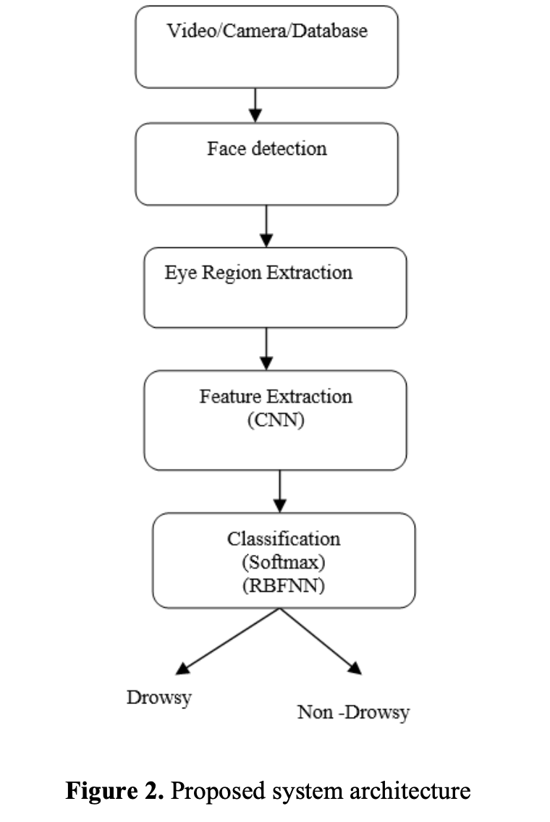
System Architecture

Slide 8
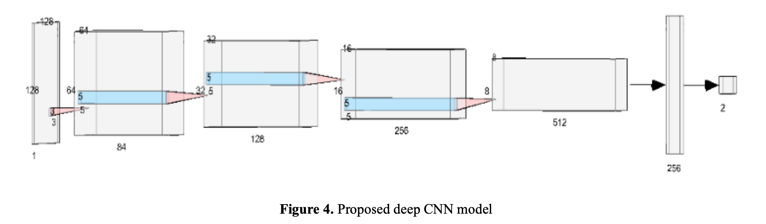
Model Architecture
Four Convolutional layers, 1 fully connected layer (image size – 128 x 128).
Four Convolutional layers extract features using filters(84, 128, 256, 512). Filter size (3x3, 5x5).
Fully connected layer to flatten features (combine) for classification.
Softmax activation for classification.
BatchNormalisation and ReLU for improving model stability and performance.
Dropout (0.25%).
Adam optimizer to control the learning rate.
12,757,874 trainable parameters.

Slide 9
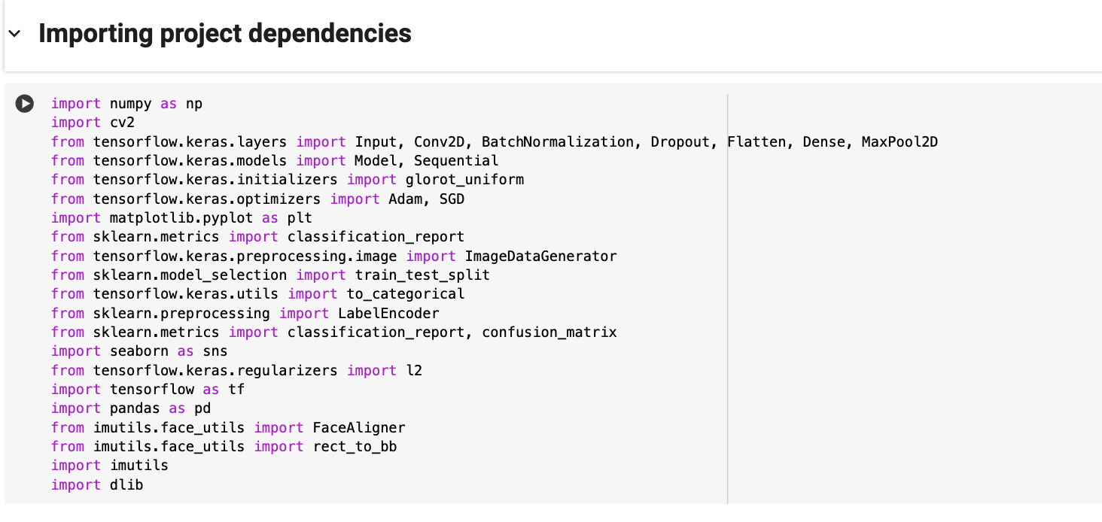
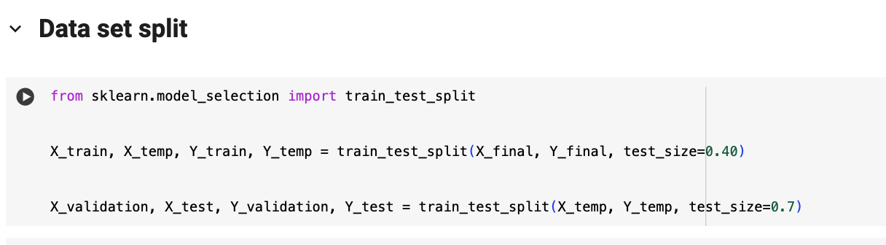
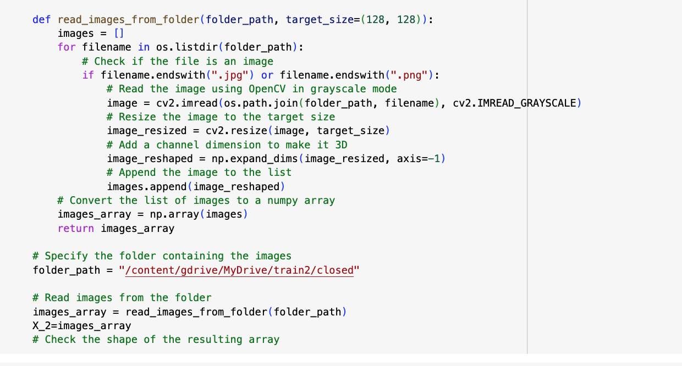
Implementation
Used tensor flow – keras module.
Imported datasets and preprocessed.
Split the dataset.

Slide 10
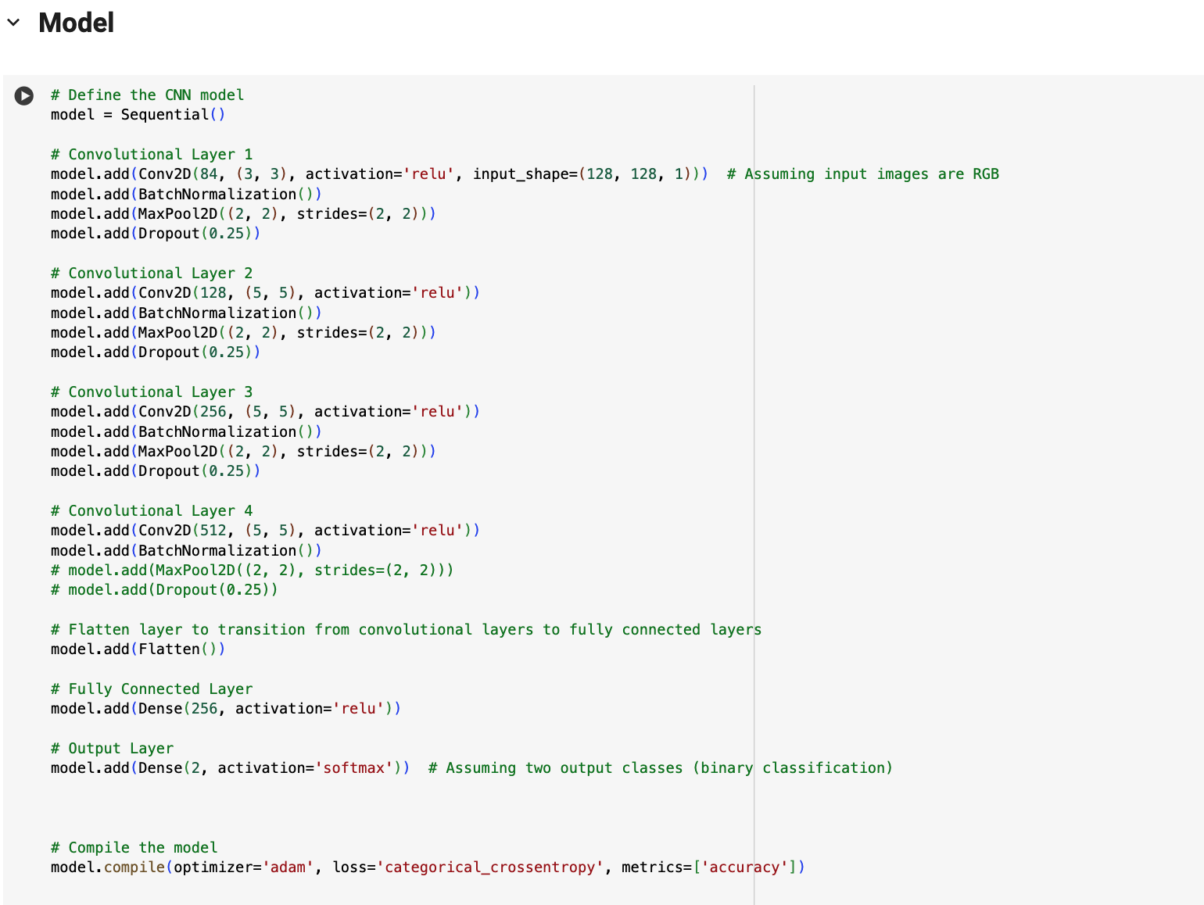
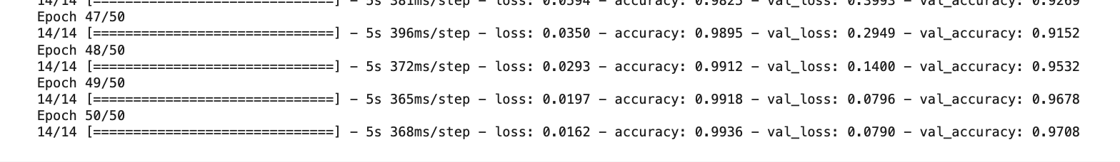
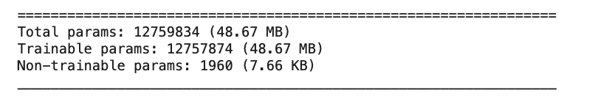
Implementation
Built the model from paper’s model description and trained it.

Slide 11
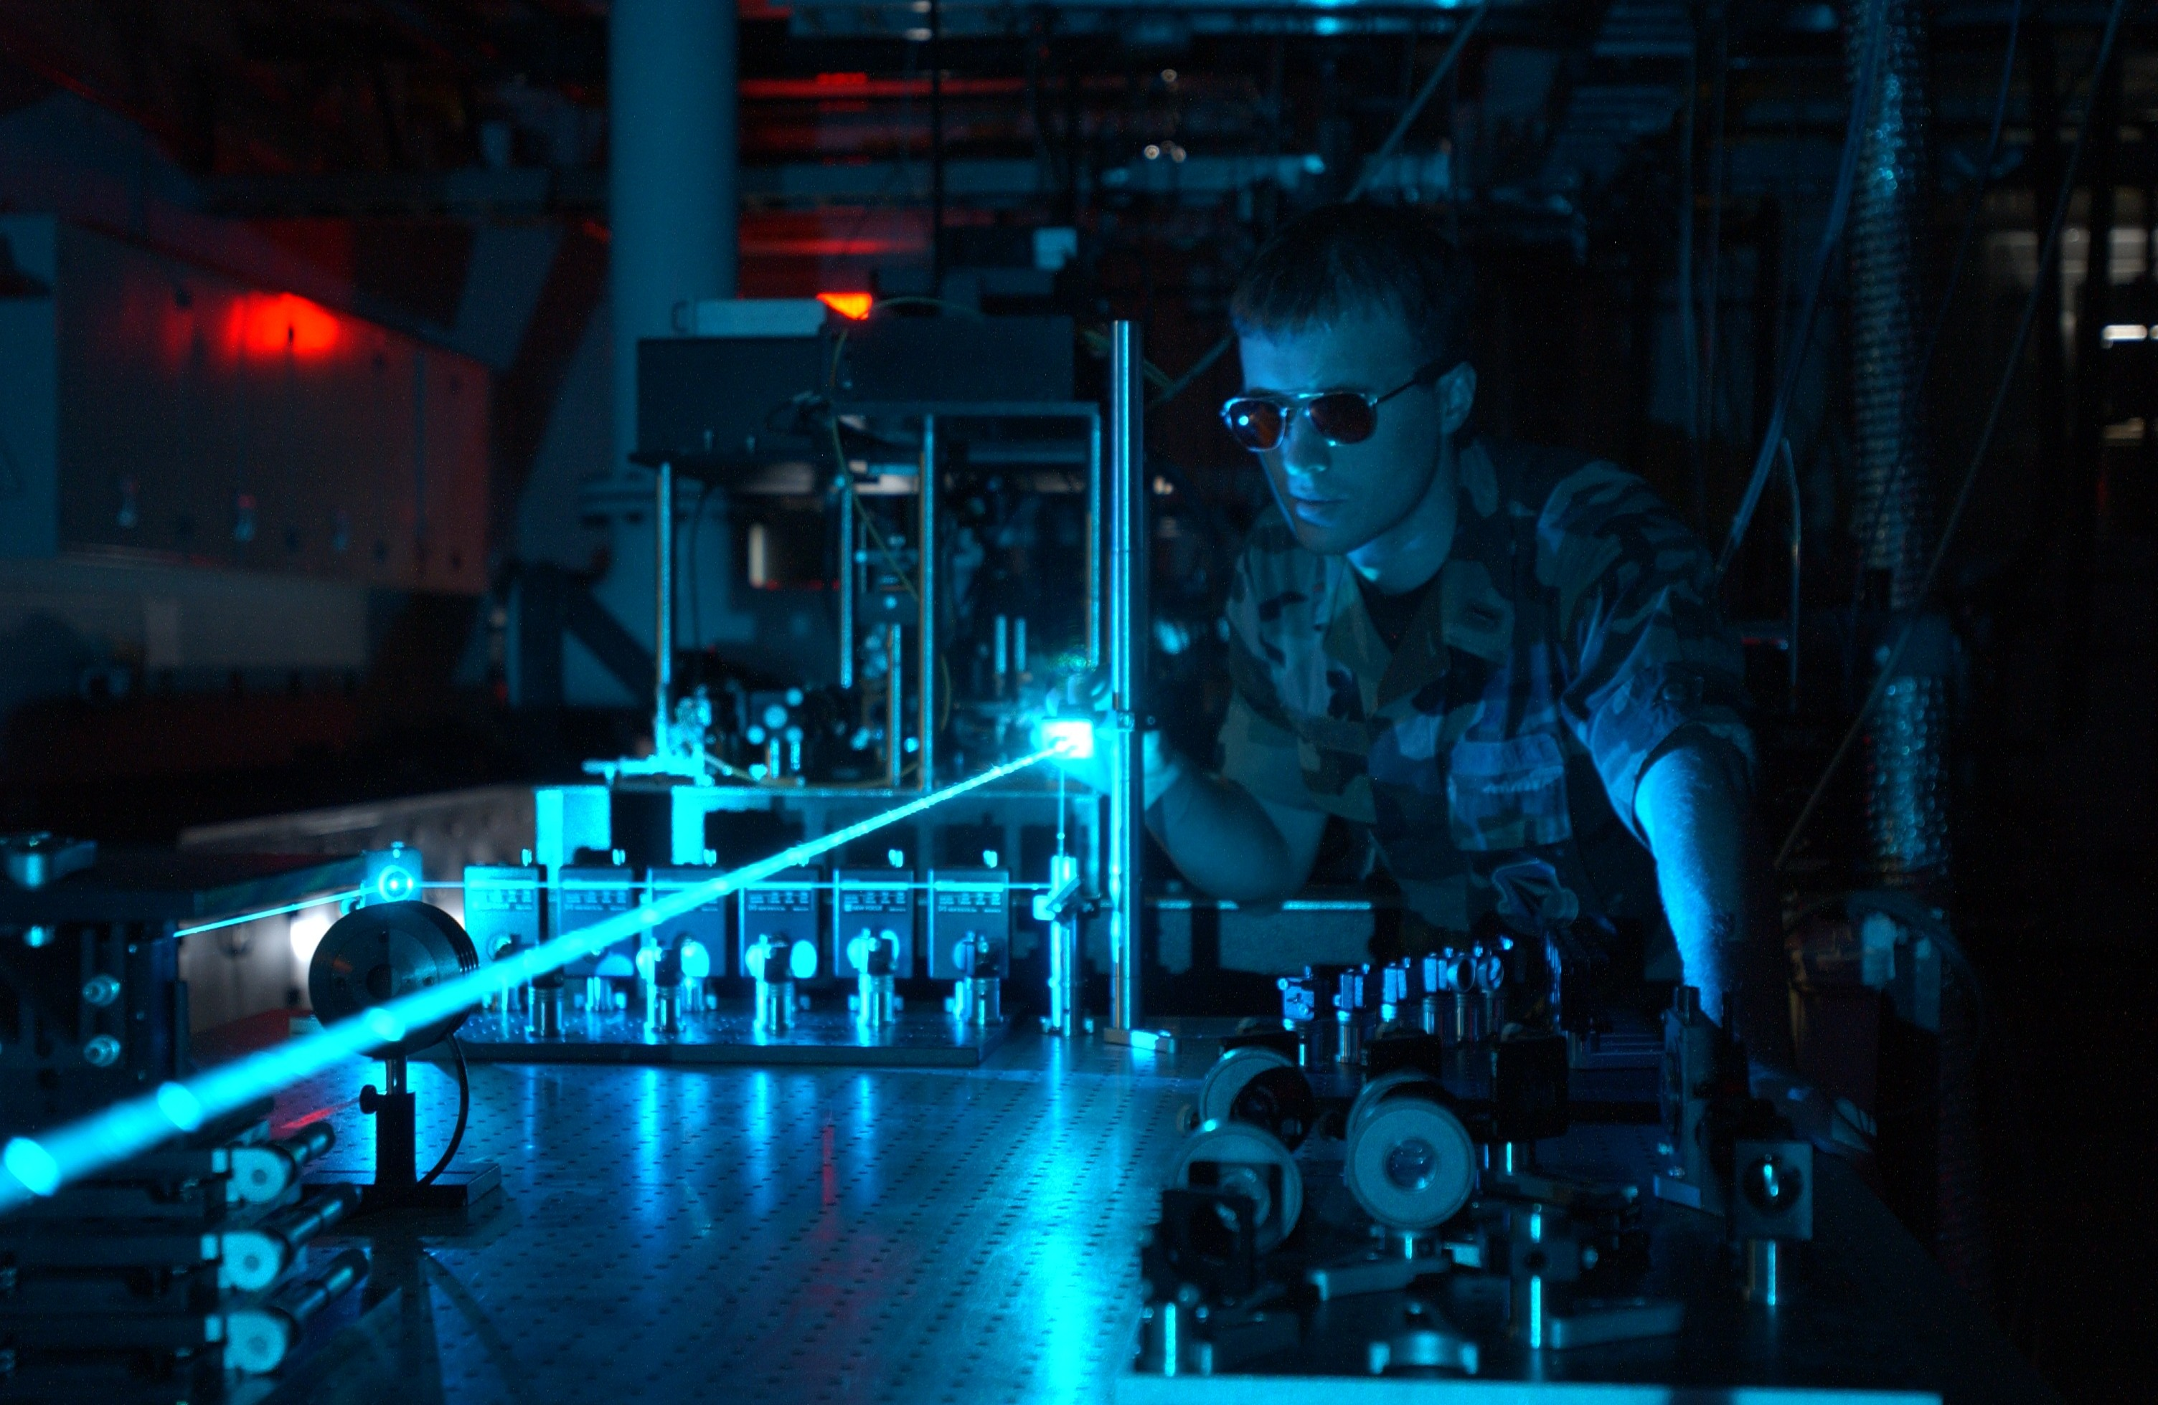
Testing
Performed 10 experiments.
Tested the model with different epochs, different batch sizes, and dataset split sizes.
Epochs - dataset size
Tested with validation dataset and without validation dataset.
Inclusion of validation dataset improves model performance on the unseen data.
This Photo by Unknown author is licensed under CC BY-SA.

Slide 12
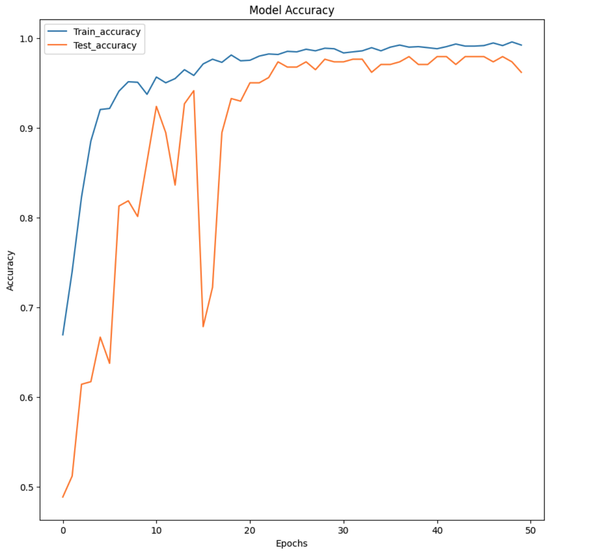
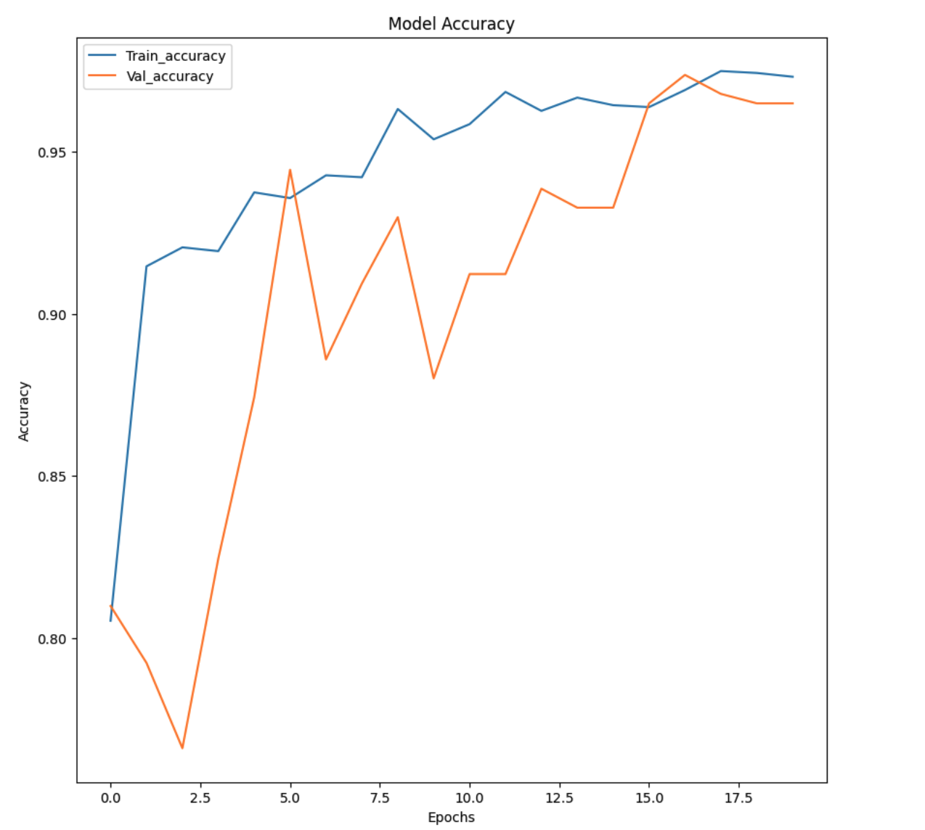
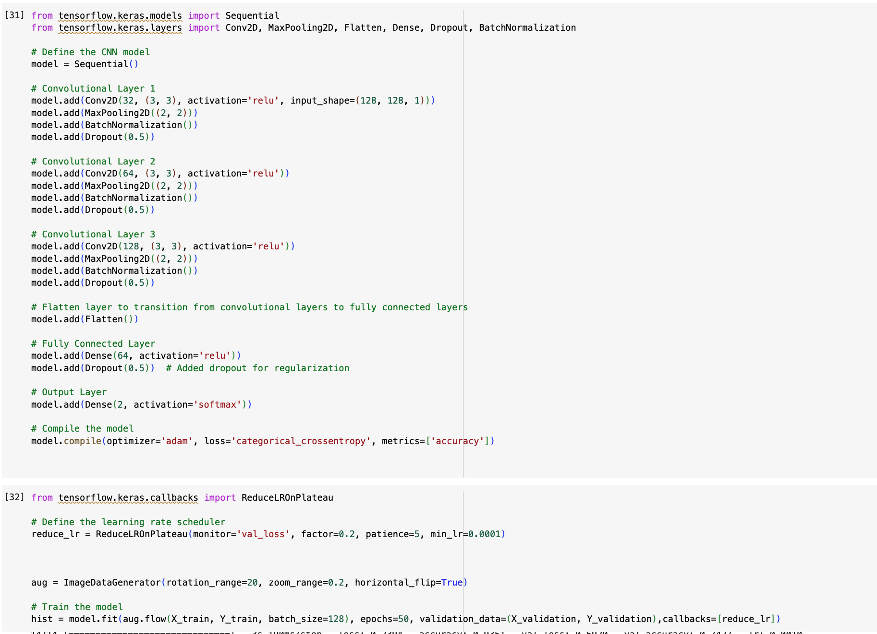
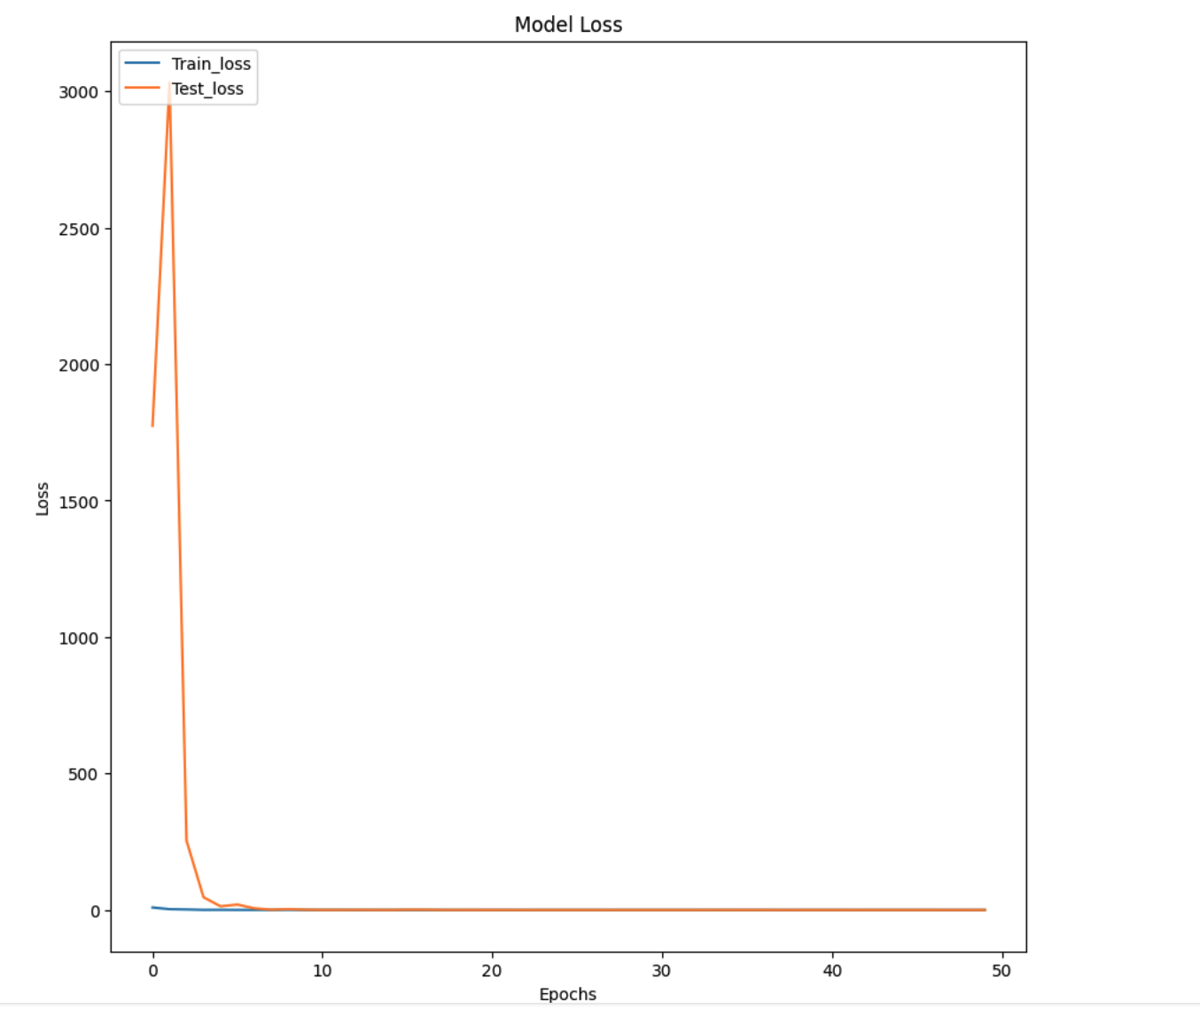
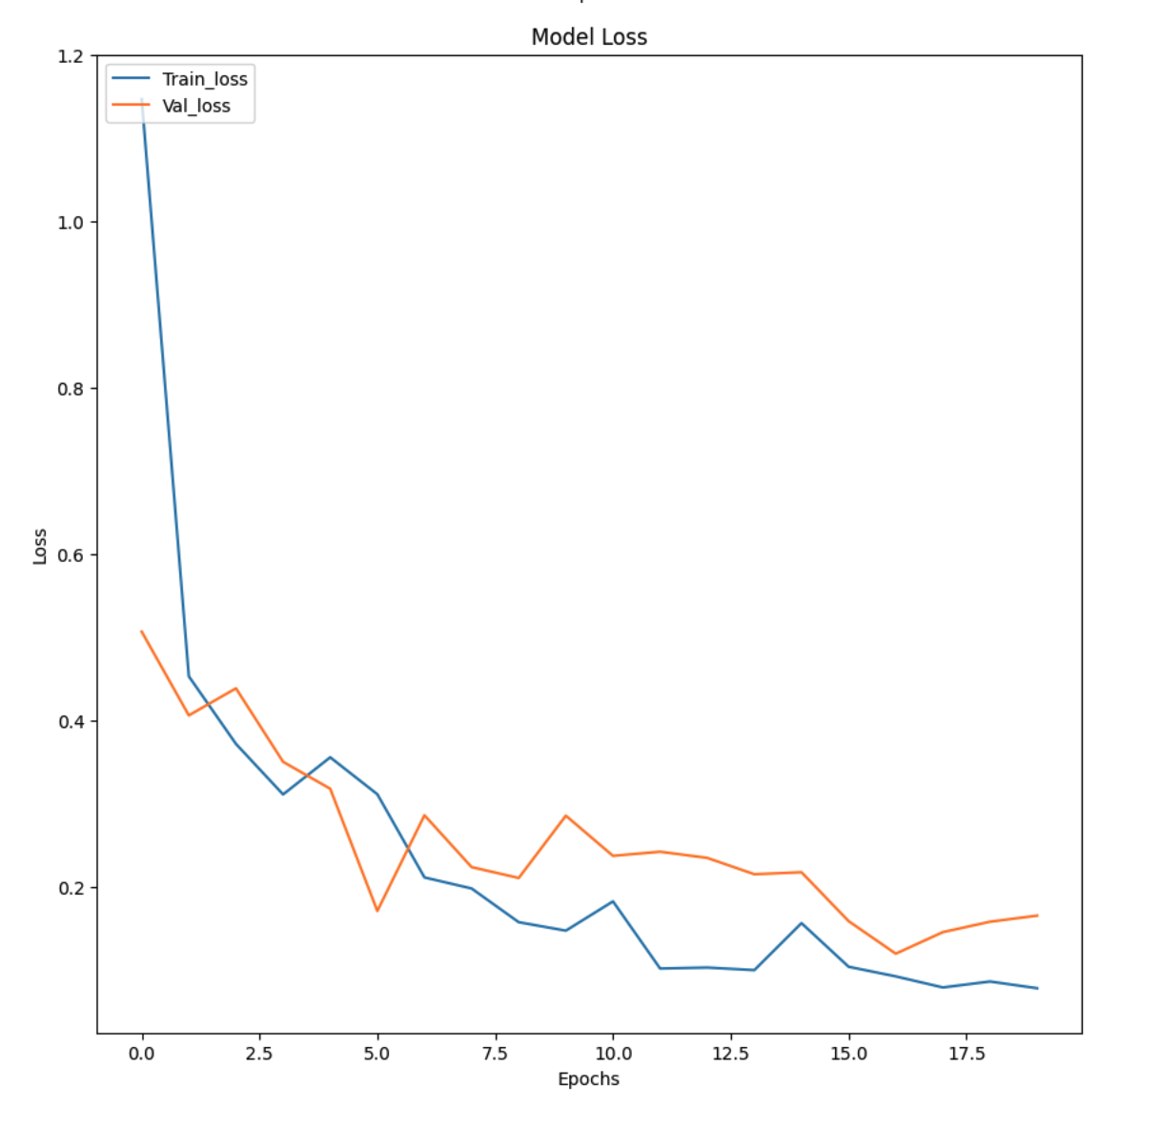
Testing Results
Experiment 9
Experiment 10
Modified architecture
Increased dataset size, manually adjusted learning rate, increased dropout rate.
Reduced 12,757,874 to 1698946 parameters

Slide 13
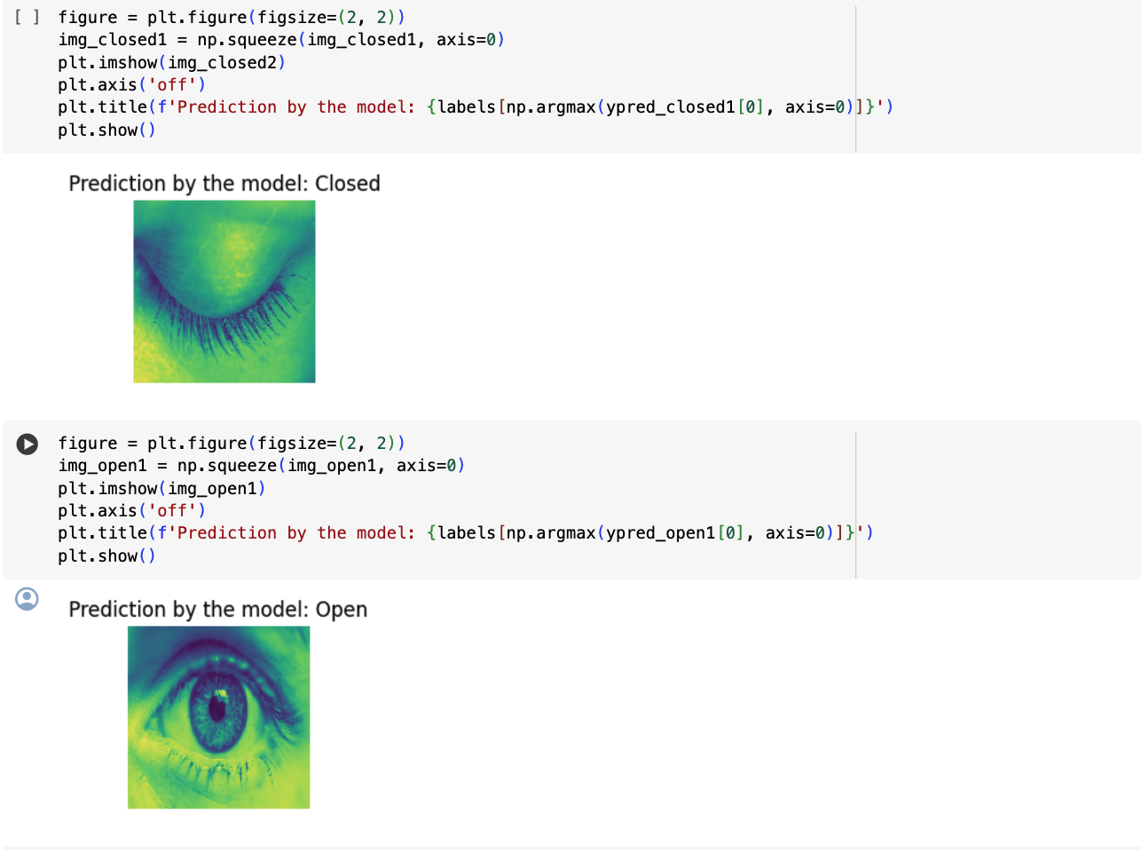

Slide 14
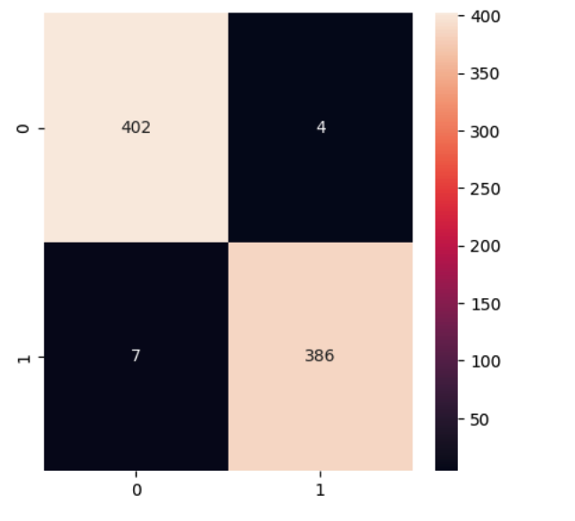
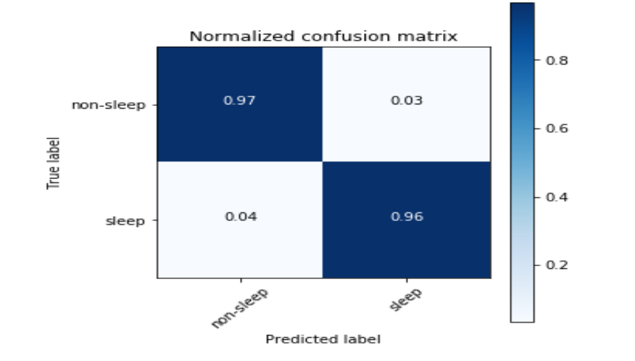
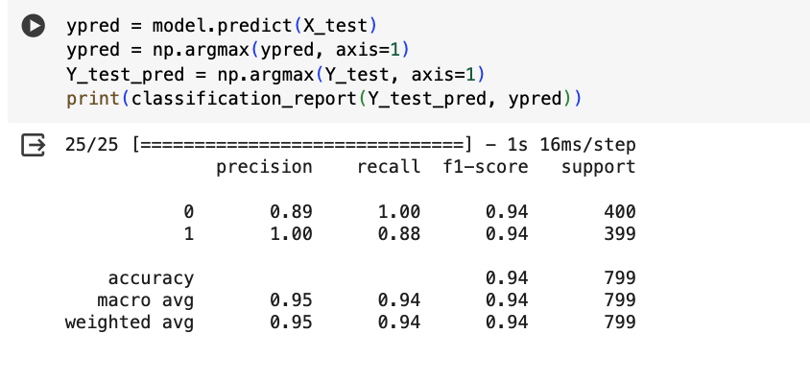
Comparison
<
Paper accuracy (96 %)
Our accuracy (98%)

Slide 15

Comparison
Dataset Quality: High-resolution images and clear categorization enhanced training effectiveness.
Balanced Data: Even distribution between drowsy and non-drowsy states minimized learning bias.
Split Configuration: 60-40 training-test split, with a further 70-30 division for testing and validation, ensured thorough evaluation.
Improvements: Adjustments in the CNN architecture significantly enhanced the model's performance.

Slide 16

Discussion
Employed a deep CNN for tracking and analyzing complex features like eye closure.
Leveraged open-source, pre-trained model to speed up development and ensure robustness.
Implemented strategies such as adjusting the architecture and adjusting dataset splits to mitigate overfitting.
Combined diverse skills and perspectives, enhancing execution and results through collaborative efforts in data handling and testing.

Slide 17

Takeaways
Team Collaboration: Enhanced project outcomes through effective teamwork.
Model Flexibility: Adapted model parameters like epoch size, data splitting, etc for optimal results.
Topic Relevance: Addressed a practical issue with significant real-world implications.
Resilience and Learning: Overcame challenges and learned from initial setbacks in coding and project direction.

Slide 18
Conclusion
Larger epoch sizes generally lead to improved accuracy
Optimal epoch size and configuration depend on dataset characteristics and model architecture
Highlighted issue of overfitting and strategies for improvement
Conclusion: Project advances understanding of deep learning in real-world scenarios and sets foundation for future exploration of nuanced machine learning strategies in driver safety.

Slide 19

Questions?

